Slide 1

EASWARI ENGINEERING COLLEGE
AgriVision
AI-Driven Crop Disease Prediction via MERN Stack & CNN
SUBJECT : Full Stack Development
PRESENTED BY : MADHAN V M
310624104172
ZERO’TH REVIEW

Slide 2
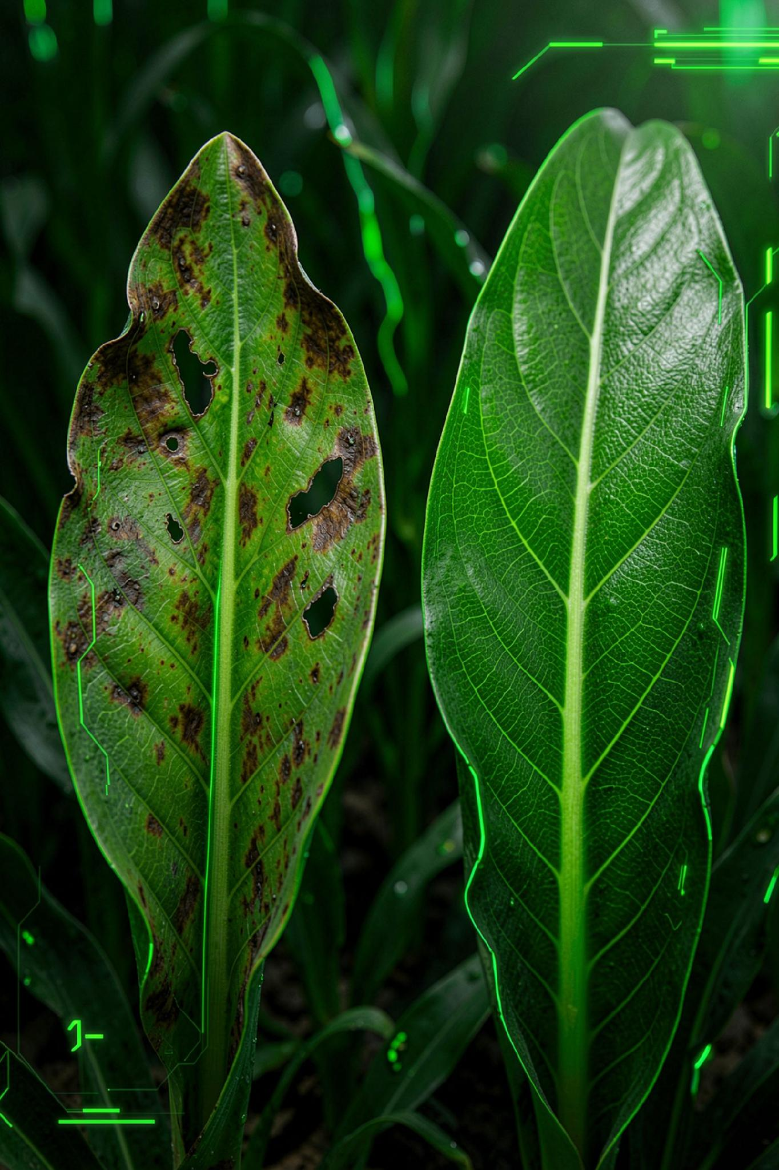
Table of Contents
01
02
Abstract
Problem Statement
03
04
Proposed Solution
Objectives
05
06
System Modules
System Workflow
07
08
Technology Stack
System Architecture
09
10
Expected Outcome
Conclusion

Slide 3
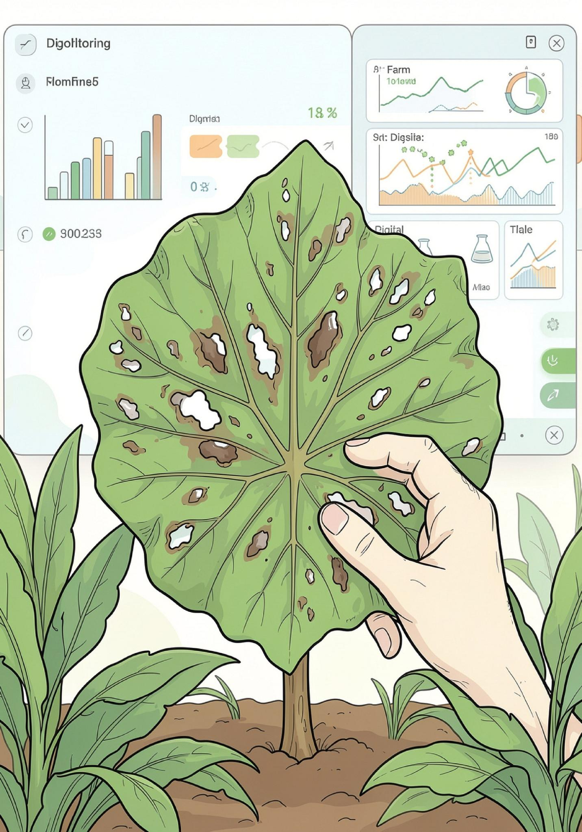

Abstract
Agricultural ecosystems face growing pressure from fungal and bacterial pathogens that degrade crop yield, threaten food security, and increase the burden on farm management teams. Monitoring bodies and farmers must track disease reports, verify affected sites, coordinate treatments, and record farm health readings, but these tasks are often handled through manual logs and disconnected communication channels that slow response times and reduce accuracy.
This project presents a web-based Crop Disease Tracking and Monitoring System that digitalizes and centralizes the entire workflow. Farmers can submit disease incidents, administrators can verify affected locations, and the integrated CNN model compares uploaded image readings against predefined disease thresholds to detect hazardous conditions early. Once treatment is verified, a digital agricultural report is generated and made available through a central dashboard, improving responsiveness, transparency, and decision-making in farm management.
Digital tracking can reduce reporting delays, improve verification accuracy, and enable faster treatment decisions for affected crops.
Manual reporting risks delay & poor tracking
Centralized digital platform
Auto threshold-based disease alerts

Slide 4
Problem Statement
Crop diseases are an escalating threat to global agriculture. Agricultural teams must track incoming disease reports from many sources, verify affected crops, assign experts, and record field data, typically relying on manual logs, scattered spreadsheets, and disconnected communication.
This creates delays in identifying outbreaks, makes it harder to coordinate treatments across teams, and increases the risk of incomplete or inconsistent farm records. Farmers and field officers need a centralized digital system that can manage the full lifecycle of a disease report, from submission and verification to treatment coordination and compliance tracking, with clear role-based access for farmers, field officers, and administrators.
MANUAL WORKFLOW FRICTION POINTS
Scattered, paper-based incident logs
Reports are captured inconsistently across notebooks, forms, and spreadsheets.
Difficult disease hotspot tracking
Teams struggle to see where outbreaks are spreading and which farms need attention first.
Time-consuming manual process
Every step from reporting to follow-up depends on repeated human checks and handoffs.
Delayed treatment response
Slow coordination can reduce the effectiveness of treatment and worsen crop damage.
Key challenges farmers face
Manual reporting slows down incident capture and increases the chance of errors
Delays in verification and escalation can allow disease to spread across fields
Lack of coordination makes it difficult to assign the right experts at the right time
Disjointed records make long-term tracking, compliance, and reporting unreliable

Slide 5
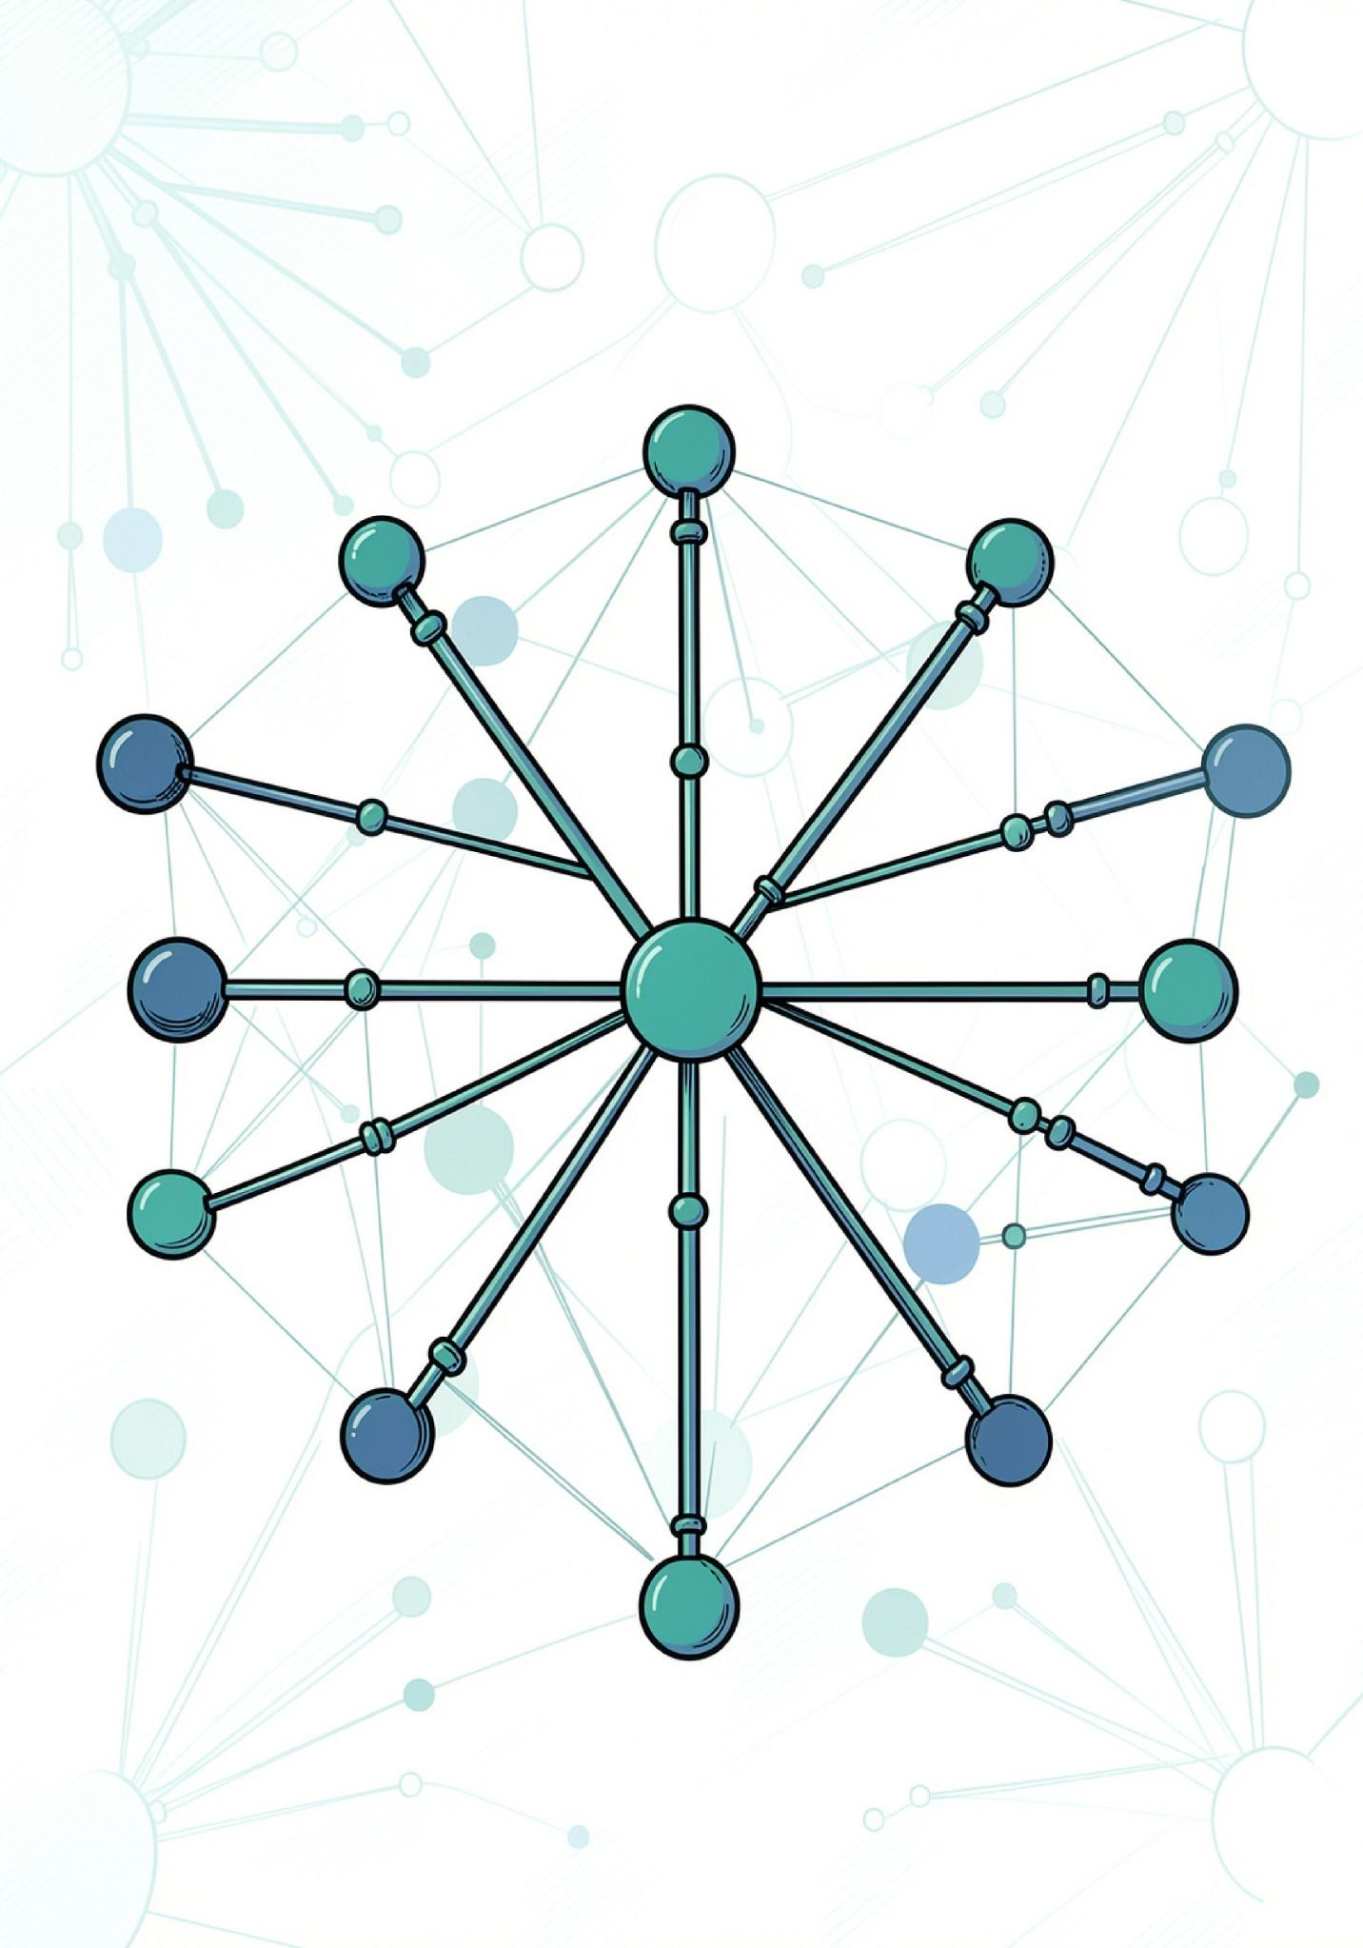
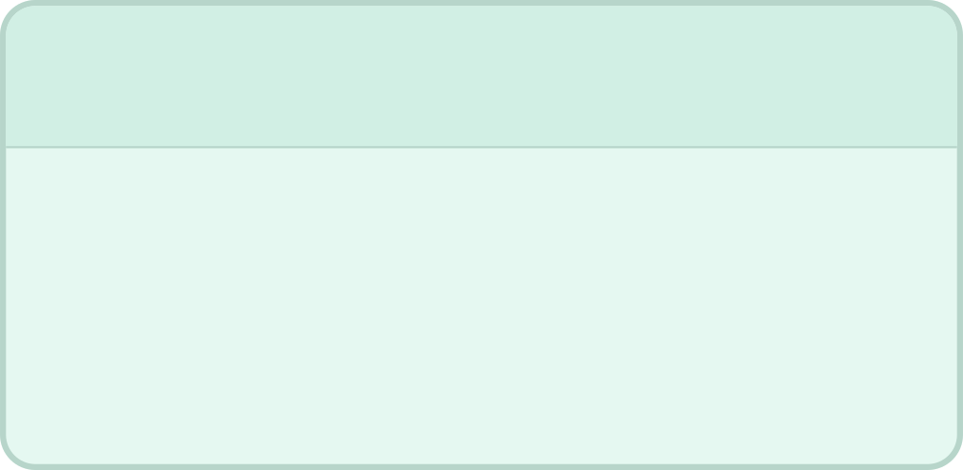


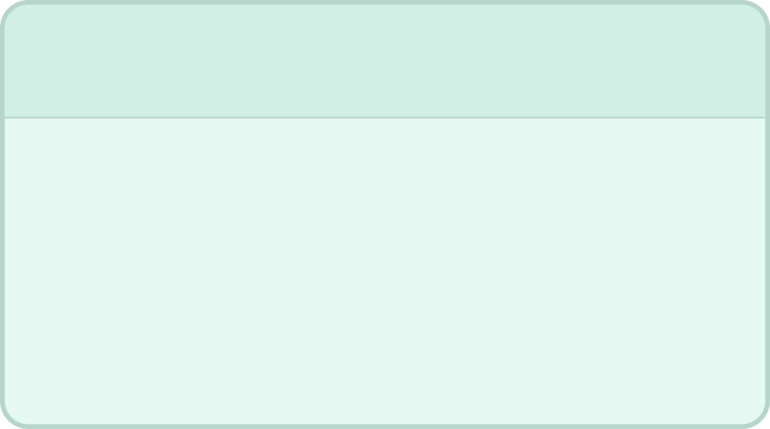


Proposed Solution
This platform is designed as a centralized web application that connects farmers, agricultural officers, and administrators within a single digital platform, transforming disease reporting and treatment coordination into a structured, trackable digital process.
Centralized platform
AI diagnosis
One system for farmers, officers, and administrators to manage every report.
Intelligent analysis helps identify likely disease patterns and status updates.
Real-time tracking
Treatment coordination
Monitor incidents, hotspots, and progress as reports move through the system.
Assign tasks, coordinate field action, and track treatment completion.

Slide 6
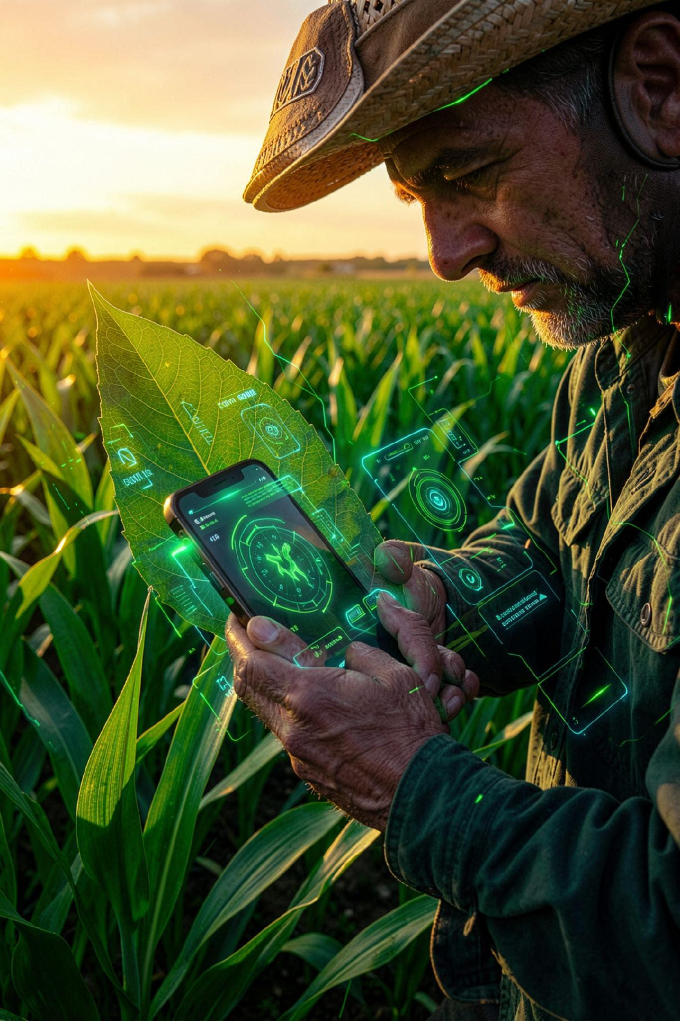
Project Objectives
🌿
01
Digitalize the crop disease reporting process.
🌿
02
Generate unique identification numbers for every report.
🌿
03
Provide role-based access for Farmers, Officers & Admins.
🌿
04
Enable farmers to record treatment and crop health data digitally.
🌿
05
Auto-compare CNN image classifications with predefined safe thresholds.
🌿
06
Identify compliant and non-compliant/hazardous plant states.
🌿
07
Improve disease incident tracking throughout its lifecycle.
🌿
08
Generate agricultural compliance reports after verification.
🌿
09
Reduce manual work and minimise diagnostic response delays.

Slide 7





Main System Modules
Farmer / Reporter Module
Agricultural Officer Module
Admin Module
AI Engine Module
Manage users, verify incoming reports, assign field officers, approve agricultural reports & monitor farm compliance.
Automatically evaluates uploaded leaf imagery against trained deep learning thresholds to determine disease hazard status.
Submit disease reports with location and image, monitor report status, and view resolution updates and environmental reports.
View assigned disease reports, record health readings and treatment actions, and update investigation status.

Slide 8
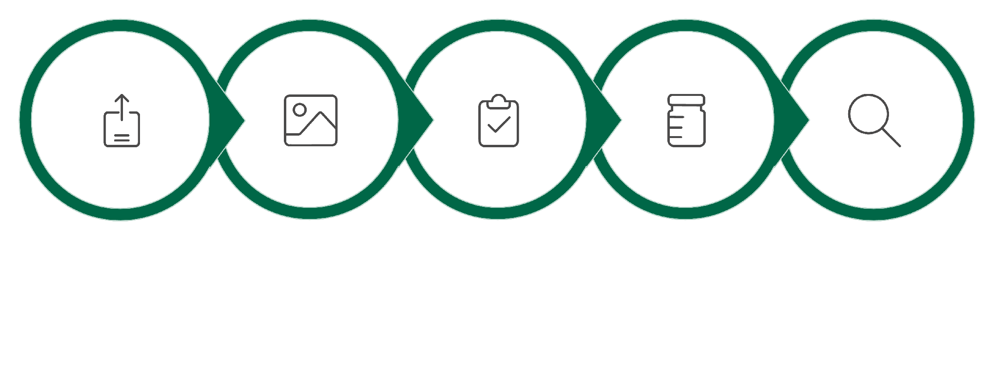
System Workflow
Submit Report
Treatment Assignment
Health Tracking
AI Analysis
Verification
Complete Report-to-Treatment Lifecycle — Fully Digital, Fully Tracked.

Slide 9

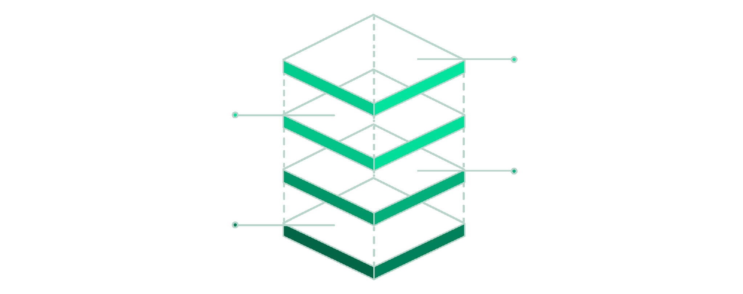



Technology Stack & System Architecture
React.js — Frontend
Responsive UIs, dashboards, incident forms and disease hotspot tracking pages.
Node.js + Express.js — Backend
AI Service
Python / TensorFlow inference
REST APIs, authentication, business logic, threshold calculations, report management.
Database
MongoDB storage layer
Backend
Node.js / Express APIs
MongoDB — Database
Frontend
React UI & dashboards
Stores users, reports, CNN readings, treatment records and compliance data.
Python / TensorFlow — AI Service
Handles image processing, model inference, and CNN tensor calculations.

Slide 10
Functional & Non-Functional Requirements
⚙ Functional Requirements
🔒 Non-Functional Requirements
▸ Secure User Registration
JWT-based session management with role-based access control for Farmer, Officer, and Admin personas.
▸ Interactive Image Upload
Drag-and-drop UI supporting high-resolution leaf image uploads with live preview.
▸ Automated CNN Inference
ResNet-50 model returns predicted disease label and confidence score in < 3 s.
▸ Historical Dashboard
Farmers can browse, filter, and export their full prediction history and health trends.
▸ Performance
AI inference response < 3 seconds; API endpoints respond < 500 ms under normal load.
▸ Scalability
Microservice design — Node.js and Flask scale independently via container orchestration.
▸ Security
Bcrypt password hashing, JWT expiry, HTTPS-only cookies, and input sanitisation.
▸ Usability
Fully responsive mobile-first React frontend; WCAG 2.1 AA colour contrast compliance.

Slide 11
Detailed System Architecture
Decoupled microservices: Node.js handles UI and DB logic, proxying image payloads to the isolated Flask AI service to prevent event-loop blocking.
React.js (Frontend UI)
CLIENT TIER
Vite build toolchain · Axios HTTP client · React Context auth state · Role-based routing
↓
Node.js & Express.js (REST Routing & Auth)
API GATEWAY
JWT middleware · Multer file handling · Mongoose ODM · Proxy to Flask /predict endpoint
↓
Python & Flask (ResNet-50 CNN Inference)
AI ENGINE
PyTorch model loading · Image pre-processing (224×224 normalise) · JSON confidence response
↓
MongoDB (NoSQL Document Store)
DATA TIER
Users · Predictions (1-to-many) · Treatments · In-memory fallback for dev environments

Slide 12
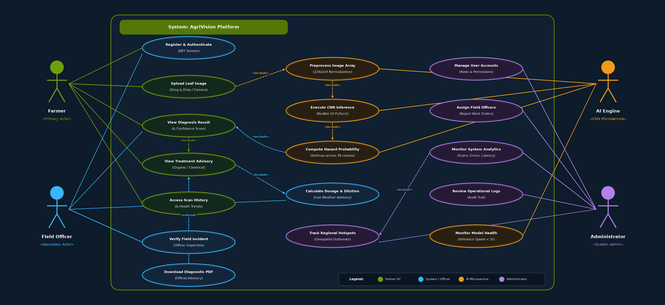
Use Case Diagram

Slide 13
Entity-Relationship (ER) Schema
MongoDB NoSQL document collections — relationships modelled via embedded documents and userId references.
👤 Users Collection
🔬 Predictions Collection
💊 Treatments Collection
_id : ObjectId
Primary Key
fullName : String
User display name
email : String
Unique login identifier
passwordHash : String
Bcrypt hash — never stored plain
role : Enum
'farmer' | 'officer' | 'admin'
createdAt : Date
ISO 8601 timestamp
_id : ObjectId
Primary Key
userId : ObjectId
Foreign Key → Users._id
imageUrl : String
Stored image path / CDN URL
predictedDisease : String
CNN output label (38 classes)
confidenceScore : Float
0.00 – 1.00 probability
cropSpecies : String
User-entered crop name
scannedAt : Date
Timestamp of scan
diseaseName : String
Primary Key — matches CNN label
organicTreatment : String
Neem oil, copper sulphate, etc.
chemicalTreatment : String
Fungicide / bactericide protocol
preventionSteps : Array
Ordered list of prevention tips
severity : Enum
'low' | 'medium' | 'high'
→

Slide 14
Detailed Module Description
🔐 01. User Auth Module
🤖 02. AI Diagnostic Module
Node.js · Express · JWT · Bcrypt
Python · Flask · PyTorch · ResNet-50
Handles end-to-end identity: registration form validation, Bcrypt hashing before MongoDB write, JWT issuance on login, role middleware protecting /farmer, /officer, /admin routes, and automatic token refresh on every API request.
Isolated microservice on port 5000. Loads pre-trained plant_disease_model.pth at startup. Accepts multipart image POST, resizes to 224×224, normalises with ImageNet mean/std, runs forward pass, and returns top-1 disease label + confidence.
💊 03. Treatment Mapping Module
📊 04. History Dashboard Module
Node.js · MongoDB · Mongoose
React.js · Axios · Chart.js
Business logic layer correlating CNN output disease string with the Treatments collection. Returns structured organic remedy, chemical protocol, and ordered prevention steps. Falls back to in-memory store during development when MongoDB is unavailable.
React component aggregating all historical scans for the authenticated farmer. Renders a timeline chart of disease frequency, sortable/filterable prediction table, and export to CSV. Real-time update via polling /api/history every 30 s.

Slide 15
Technology Stack Breakdown
🖥️ Frontend UI
React.js 18 · Vite 5 · Tailwind CSS 3 · Axios · React Router v6
SPA with role-based routing, responsive layouts, drag-and-drop scanner, WebRTC camera.
⚙️ Backend API
Node.js 20 · Express.js 4 · JWT (jsonwebtoken) · Multer · Bcrypt.js
RESTful API gateway: auth, predict-proxy, history, operations, weather, recommendation routes.
🤖 AI Microservice
Python 3.10 · Flask 3 · PyTorch 2 · ResNet-50 · Pillow / OpenCV
Isolated on port 5000; loads plant_disease_model.pth; returns JSON disease + confidence.
🗄️ Database & Storage
MongoDB Atlas / Local · Mongoose ODM 8 · In-Memory Dev Store · GridFS (images)
Document store with Users, Predictions (1-many), Treatments collections.

Slide 16
UI Design & Wireframes
📊 View 1 — Farmer Dashboard
📷 View 2 — Upload Interface
🔬 View 3 — Results Modal
Clean, modern interface displaying quick statistics (total scans, disease alerts, recent activity) and a sortable/filterable table of past prediction history.
Drag-and-drop leaf upload zone with live image preview, crop species selector, farm plot notes field, and prominent 'Predict Disease' action button.
Dynamic results panel showing identified condition, AI confidence score with visual gauge, severity badge, and recommended organic & chemical treatment protocols.
┌─────────────────────────────┐
│ 🌾 Farmer Dashboard │
│ [Scans: 24] [Alerts: 3] │
│ ───────────────────────── │
│ Date Crop Disease Conf│
│ 13 Oct Tomato Late Blt 91% │
│ 11 Oct Maize Grey Leaf 78%│
└─────────────────────────────┘
┌─────────────────────────────┐
│ 📷 Scan Leaf Image │
│ ┌───────────────────────┐ │
│ │ Drop image here │ │
│ │ or tap to capture │ │
│ └───────────────────────┘ │
│ [Crop ▾] [Notes...] │
│ [ 🔍 Predict Disease ] │
└─────────────────────────────┘
┌─────────────────────────────┐
│ 🔬 Prediction Result │
│ Late Blight [HIGH ⚠️] │
│ Confidence: ████████░ 91% │
│ ───────────────────────── │
│ Organic: Copper Sulphate │
│ Chemical: Mancozeb 2g/L │
│ [📄 Export] [✓ Confirm] │
└─────────────────────────────┘
✓ KPI stat cards: scans, diseases, resolved
✓ Prediction history table with search & sort
✓ Disease frequency trend line chart
✓ Quick-scan action button (top right)
✓ Drag-and-drop + click-to-browse upload zone
✓ Mobile rear camera capture (capture=environment)
✓ WebRTC live webcam viewfinder toggle
✓ Crop species dropdown + plot notes input
✓ Disease name with severity badge (Low/Med/High)
✓ Animated confidence percentage gauge
✓ Organic & chemical treatment protocol cards
✓ Download PDF report + share button

Slide 17

AgriVision makes advanced AI actionable
What We Build
Why It Matters
A MERN-based web platform concept that connects authenticated users, image submission, CNN inference, prediction history, and treatment-oriented results through an AI microservice.
Accessible early screening can help farmers respond sooner, reduce avoidable yield loss, and support more sustainable agricultural decisions.
🌿 Leaf Anchor
🔗 API Contract
The differentiator is not the model — it is the complete workflow that puts the model in a farmer's hands.
Persistent visual identity across the entire system
Clean boundary between MERN and Python inference
Questions?
Presented by: [Madhan V M]
CLASS: [CSE III C]
REGISTER NUMBER : [310624104172]
📊 History
MongoDB-backed prediction logs for trend review
"From Image Capture to Verified Treatment."

